Slide 1
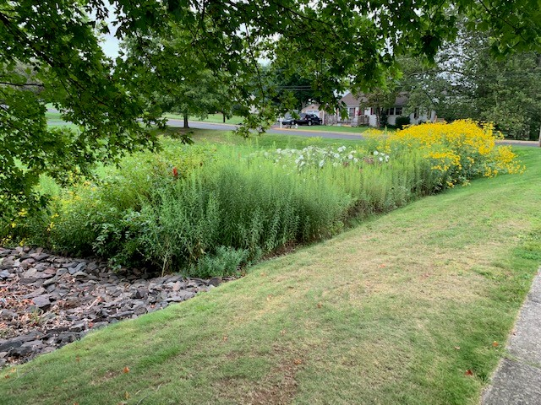
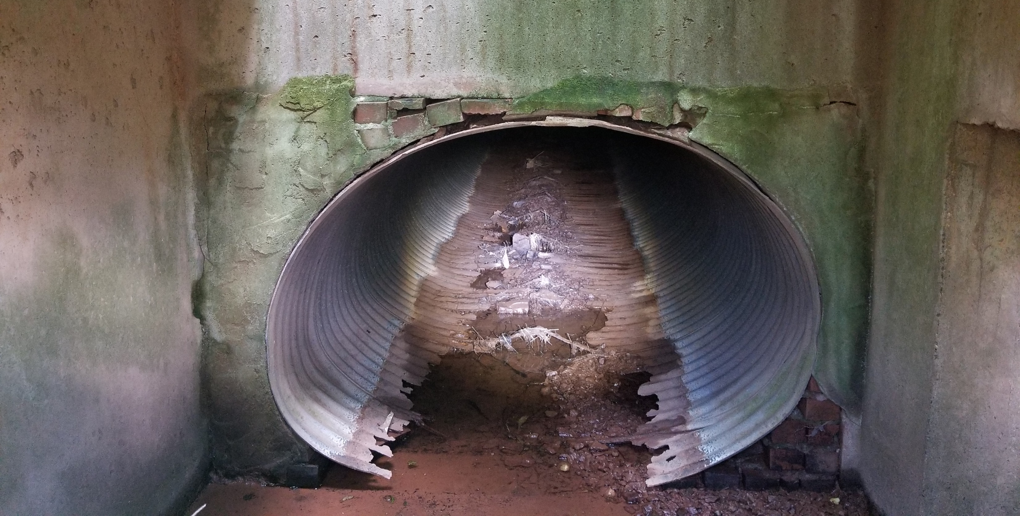
Stormwater management
Towamencin Township

Slide 2
Requirements for the Township’s PADEP Permit
Required to install Best Management Practices (BMPs) that will reduce the sediment load to Skippack Creek by 10% and total phosphorus by 5%
Township joined with Hatfield Township, Worcester Township, Skippack Township and Lower Providence Township to prepare a watershed-wide plan to meet these requirements
Permit was issued in November 2022 and the 5 Townships are required to have the BMPs completed prior to November 30, 2027.
The costs for the projects are shared between the municipalities and are weighted relative to the contributing drainage area and benefit

Slide 3
Proposed BMPs for Skippack creek multi-municipal plan
ID | BMP Project | Sediment Reduction (lbs/yr) | Probable Total Construction Cost | Municipality | Description
 | Primary Project List
1 | Worcester Basin Retrofit - Clylston Rd | 50,000 | $ 116,160.00 | Worcester | Basin Retrofit
2 | Cholet Farms Stream Restoration | 64,975 | $ 372,900.00 | Skippack | Stream Restoration
3 | Towamencin Floodplain Restoration | 131,975 | $ 415,800.00 | Towamencin | Stream Restoration and Floodplain Reconnection
4 | Worcester Stream Restoration Phase 1 | 124,775 | $ 716,100.00 | Worcester | Stream Restoration
5 | Nash Elementary Water Quality Basin | 95,400 | $ 396,000.00 | Towamencin | New WQ Basin
6 | Pennfield Middle School Regional Water Quality Basin | 33,800 | $ 264,000.00 | Hatfield | New WQ Basin
7 | Lower Providence Basin Retrofits | 18,800 | $ 165,000.00 | Lower Providence | Two Basin Retrofits
8 | Worcester Riparian Buffer | 16,400 | $ 116,160.00 | Worecester | Riparian buffer
9 | Eagleville Correctional Facility Regional Water Quality Basin | 32,600 | $ 396,000.00 | Lower Providence | New WQ Basin
10 | Perkiomen Valley Airport Bioswales | 14,400 | $ 211,200.00 | Skippack | New Bioswales
11 | Worcester Stream Restoration Phase 2 | 283,475 | $ 1,626,900.00 | Worcester | Stream Restoration
12 | Visitation Road Stream Restoration | 23,000 | $ 132,000.00 | Lower Providence | Stream Restoration
13 | Shady Brook Run Stream Restoration | 46,000 | $ 264,000.00 | Skippack | Stream Restoration
 | Totals for Primary Project List | 935,600 | $ 5,192,220.00
 | Alternative Projects
1A | Kriebel Road Stream Restoration | 330,855 | $ 1,898,820.00 | Towamencin | Stream Restoration
2A | Anders Road (Upstream of Turnpike) Stream Restoration | 211,600 | $ 1,214,400.00 | Towamencin | Stream Restoration
3A | Grist Mill Basin Retrofit | TBD | $ 116,160.00 | Towamencin | Basin Retrofit
4A | Skippack Township Recreation Area Basin Retrofits | 38,200 | $ 165,000.00 | Skippack | Two Basin Retrofits
 | Totals for Alternate Projects | 580,655 | $ 3,394,380.00

Slide 4
CoSt Distribution by Township for the Primary Project list
Municipality | Distribution (%) | Estimate per Municipality
Towamencin | 44.20% | $ 2,294,961.24
Lower Providence | 17.61% | $ 914,349.94
Worcester | 16.25% | $ 843,735.75
Skippack | 12.21% | $ 633,970.06
Hatfield | 9.73% | $ 505,203.01
 | 100.00% | $ 5,192,220.00

Slide 5
Possible Skippack Creek BMPs within Towamencin Township
BMP | Sediment Reduction (lbs/yr) | Estimated Cost
Primary List
Towamencin Floodplain Restoration – located on the northern side of Rittenhouse Road between Candlewood Way and Ridgewood Way | 131,975 | $415,800.00
Nash Elementary Water Quality Basin | 95,400 | $396,000.00
Alternate List
Grist Mill Basin Retrofits – Two Township-owned basins in the Grist Mill Neighborhood | 28,800 | $150,000.00
Bioswale along Bustard Road | TBD | $150,000.00
Possible Stream Restoration – location and length to be determined (Assume 750 LF) | 86,250 | $385,000.00
As part of the Multi-Municipal Pollution Reduction Plan, Towamencin Township is committed to provide a sediment reduction of 227,375 lbs/year.

Slide 6
Replacement of deteriorated corrugated metal pipe – Grist mill area
Grist Mill Road Storm Sewer
Preliminary Estimate of Probable Cost
# | Description | Unit cost | Quantity |  | Estimate
1 | 15 " HDPE Pipe | $ 125.00 | 470 | LF | $ 58,750.00
2 | 18" HDPE Pipe | $ 135.00 | 3365 | LF | $ 454,275.00
3 | 24" HDPE Pipe | $ 150.00 | 670 | LF | $ 100,500.00
4 | 30" HDPE Pipe | $ 175.00 | 100 | LF | $ 17,500.00
5 | 48" HDPE Pipe | $ 185.00 | 200 | LF | $ 37,000.00
6 | 43"x68" RCP Elliptical Pipe | $ 200.00 | 200 | LF | $ 40,000.00
7 | Install New Inlets | $ 7,500.00 | 58 | EA | $ 435,000.00
8 | 15" Headwalls | $ 4,000.00 | 2 | EA | $ 8,000.00
9 | 18" Headwalls | $ 4,500.00 | 8 | EA | $ 36,000.00
10 | 24" Headwalls | $ 5,000.00 | 3 | EA | $ 15,000.00
11 | 30" Headwalls | $ 6,000.00 | 2 | EA | $ 12,000.00
12 | 48" Headwalls | $ 8,000.00 | 4 | EA | $ 32,000.00
13 | 43"x68" Headwalls | $ 8,500.00 | 4 | EA | $ 34,000.00
14 | Removal of existing storm sewer and appurtenances | $ 50,000.00 | 1 | LS | $ 50,000.00
15 | Remove/Replace Concrete Curb | $ 50.00 | 2000 | LF | $ 100,000.00
16 | Remove/Replace Sidewalk | $ 30.00 | 1000 | SF | $ 30,000.00
17 | Remove/Replace HC Ramp | $ 7,500.00 | 15 | EA | $ 112,500.00
18 | Install Riprap aprons | $ 5,000.00 | 23 | EA | $ 115,000.00
19 | Temporary Pavement restoration | $ 30.00 | 2000 | SY | $ 60,000.00
20 | Permanent Pavement Restoration | $ 70.00 | 2000 | SY | $ 140,000.00
21 | Grading & Restoration | $ 10,000.00 | 1 | LS | $ 10,000.00
22 | Erosion Control | $ 5,000.00 | 1 | LS | $ 5,000.00
 | Subtotal |  |  |  | $ 1,902,525.00
 | Contingency | 20% |  |  | $ 380,505.00
 |  |  |  |  | $ 2,283,030.00
 | Design, Permitting & Construction Services | 25% |  |  | $ 570,757.50
 | Total Estimated Probable Cost |  |  |  | $ 2,853,787.50

Slide 7
Possible phasing for grist mill storm sewer replacement

